Slide 1

CA-3
Course-CSE111
(Orientation to Computing)
Name: Ankith Gottigundala
Reg. No: 12211141
Roll No.: 12
Section: K22TZ
Submitted to: DR VIPIN KUMAR

Slide 2
Platforms for Profile Creation | Link to student profile | Screens hots | Any accomplishment/ anything done
Figma | https://www.figma.com/file/ vjudKhzRfH4vomlMQyabZN/logo-design? node-id=0%3A1&t=4xdnBYvyU1GpaCW6-0 | 1. | Created a logo.
Quora | https://www.quora.com/profile/Ankith-74 | 2. | Answered to questions related to coding.
Stack overflow | https://stackoverflow.com/users/20723560/ ankith | 3. | Asked a question.
HackerRa nk, | https://www.hackerrank.com/ankithsai21004 | 4. | Practiced questions and earned a badge. Test taken to earn certificates on Python and SQL.
HackerEar th, | https://www.hackerearth.com/@ankithsai21004 | 5. | Attempted questions on basic programming and earned three badges.
Geeksfor Geeks | https://auth.geeksforgeeks.org/user/ankithsak6o8 | 6. | Practiced Coding Questions. Gave Practice Test.
CV (with projects undertake n and any MOOC’s completed ) | ---- | 7. | Created CV where details regarding my projects and achievements is mentioned along with my skills and certificates earned.

Slide 3
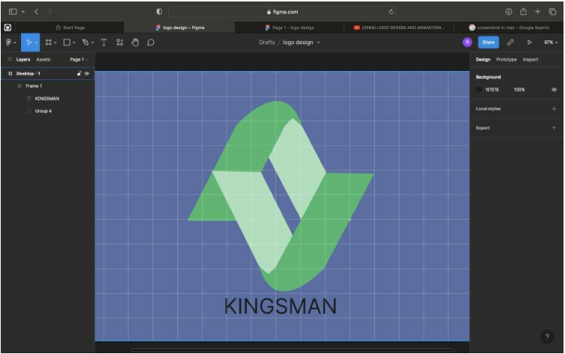
GitHub (with repositorie s and forks)
https://github.com/Ankith Reddy
8.
Created 5 repositories and forks. Also Downloaded Git software.
SCREENSHOTS…
1. Figma

Slide 4
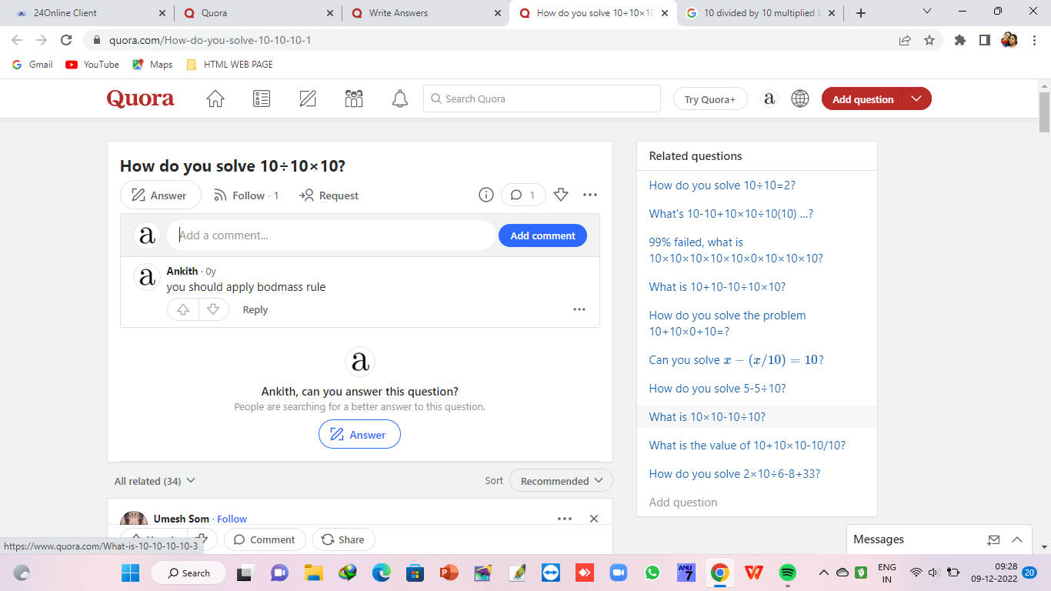
2. Quora

Slide 5
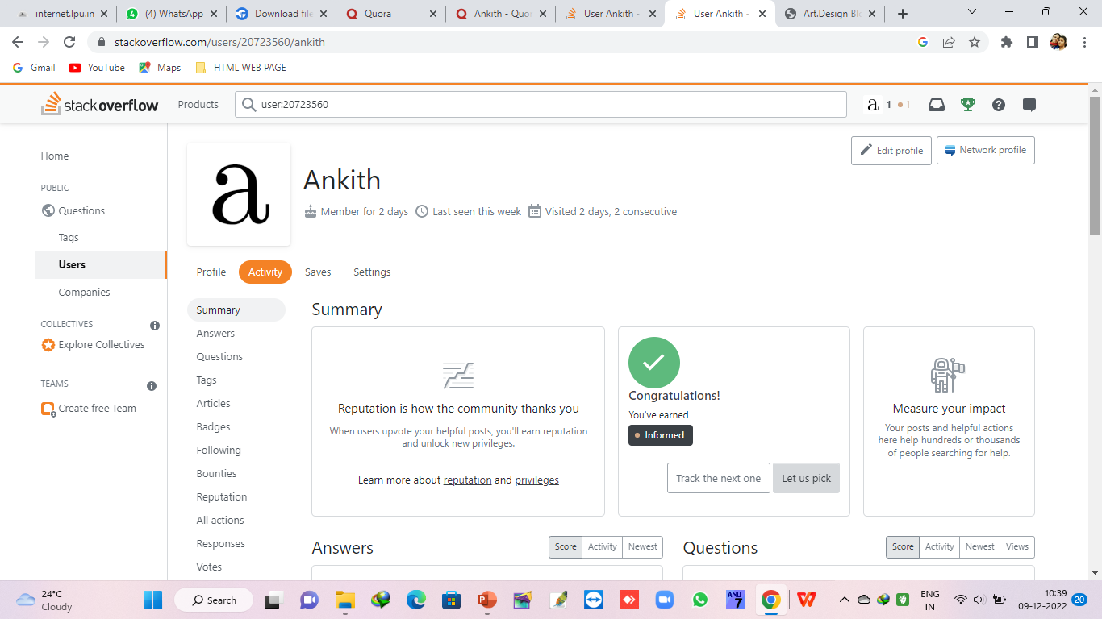
3. Stackoverflow

Slide 6
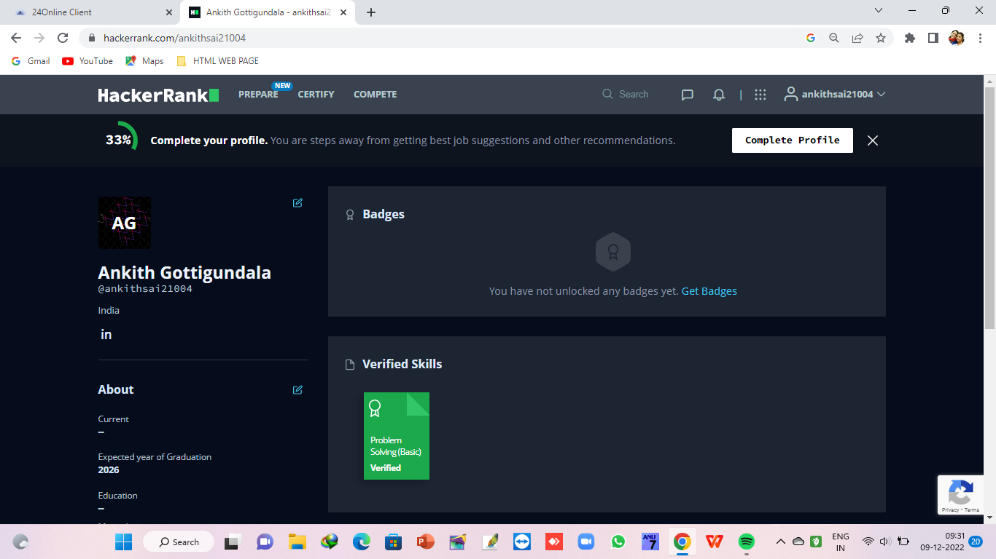
4. HackerRank

Slide 7
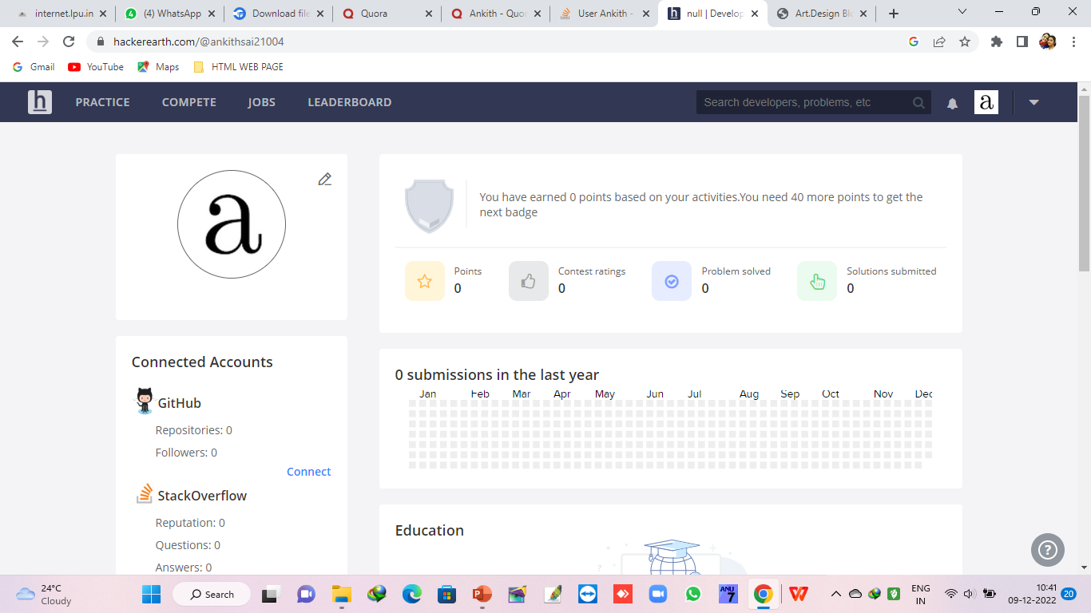
5. Hackerearth

Slide 8
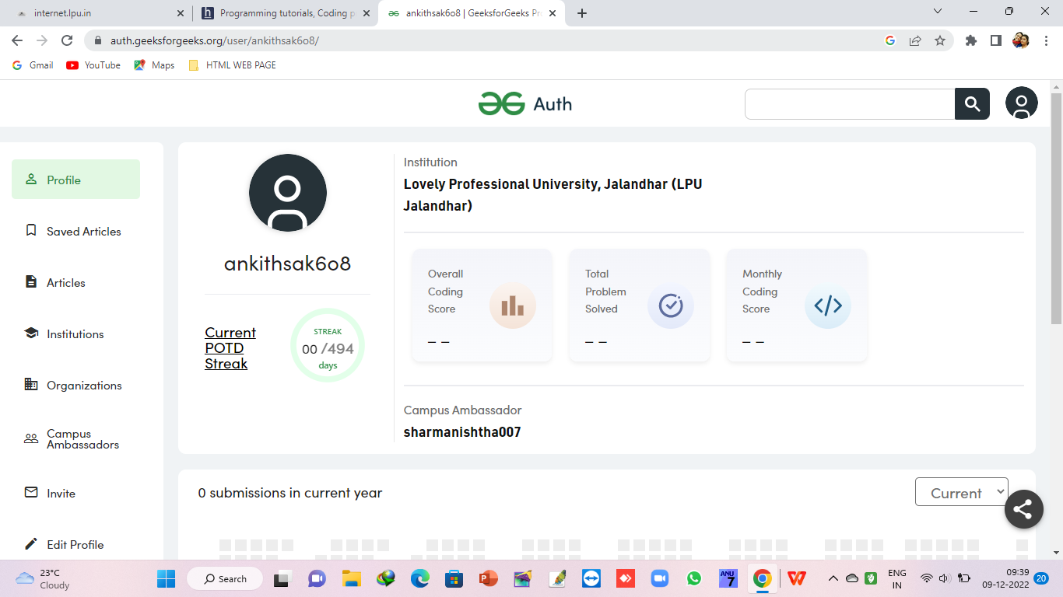
6.GEEKS FOR GEEKS

Slide 9
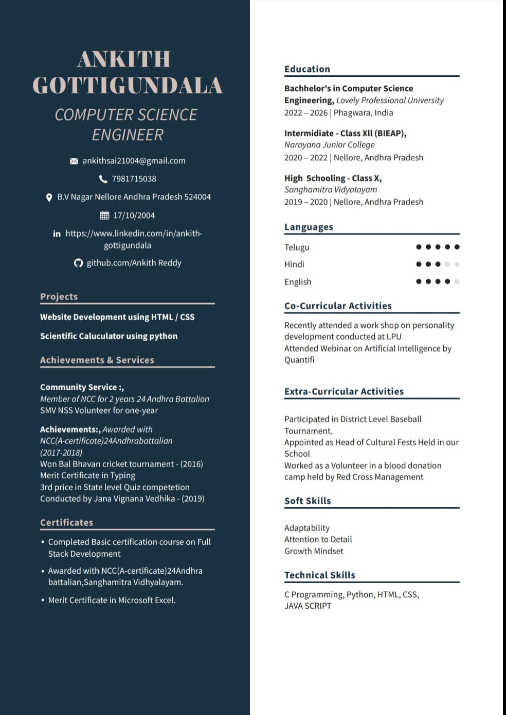
7. CV
8.GitHub

Slide 10
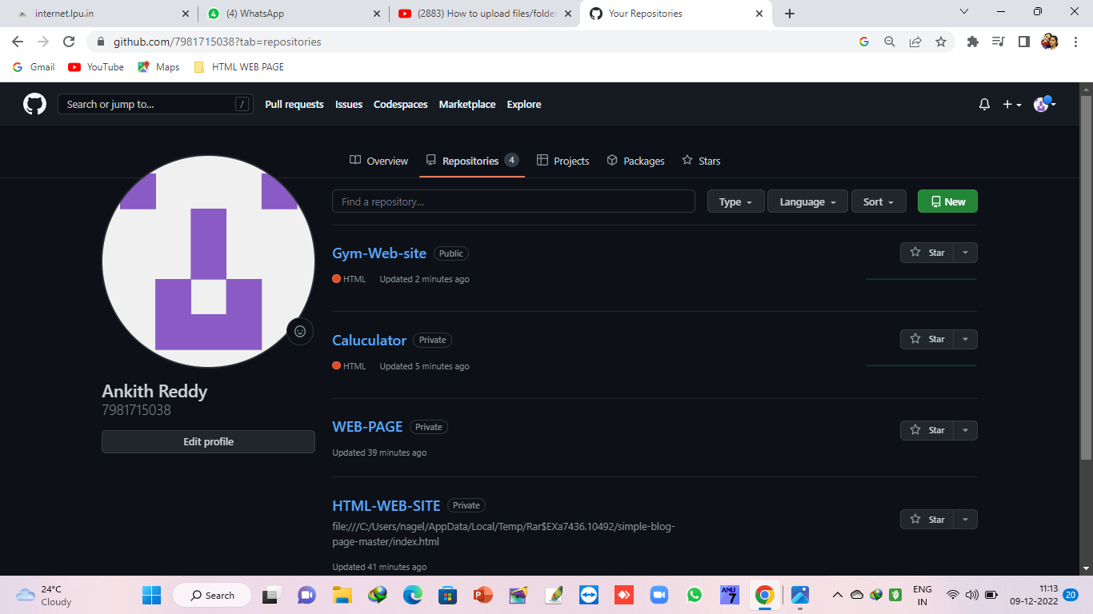
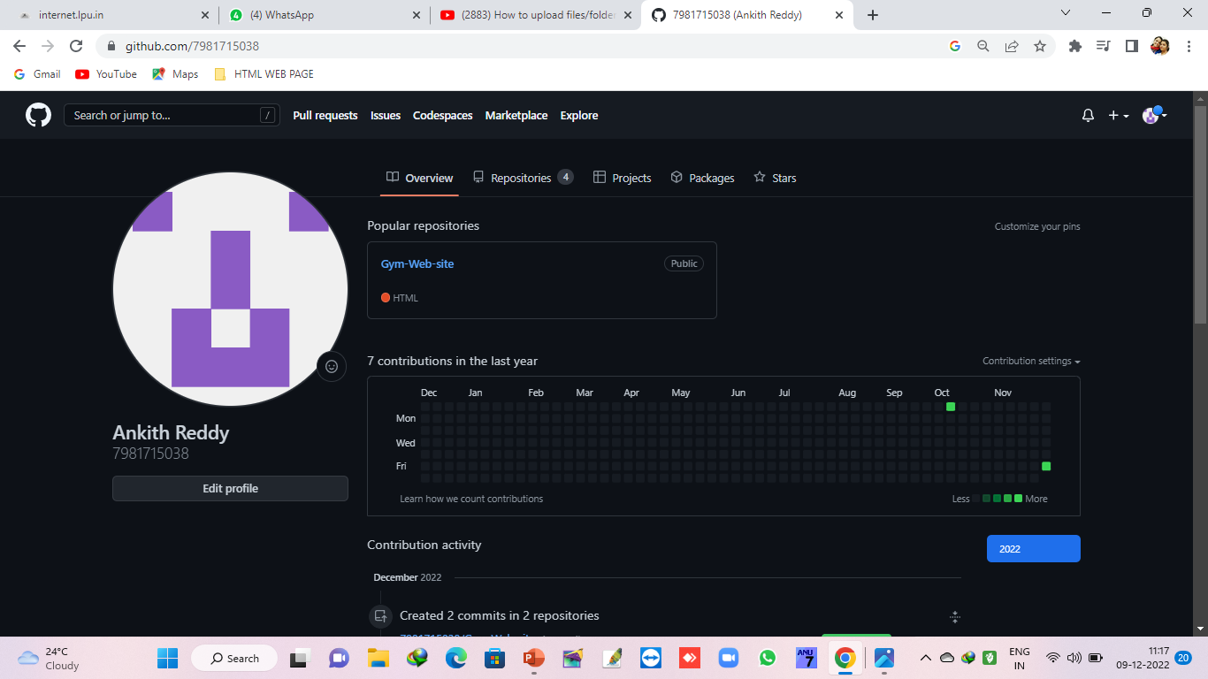
Contribution:

Slide 11
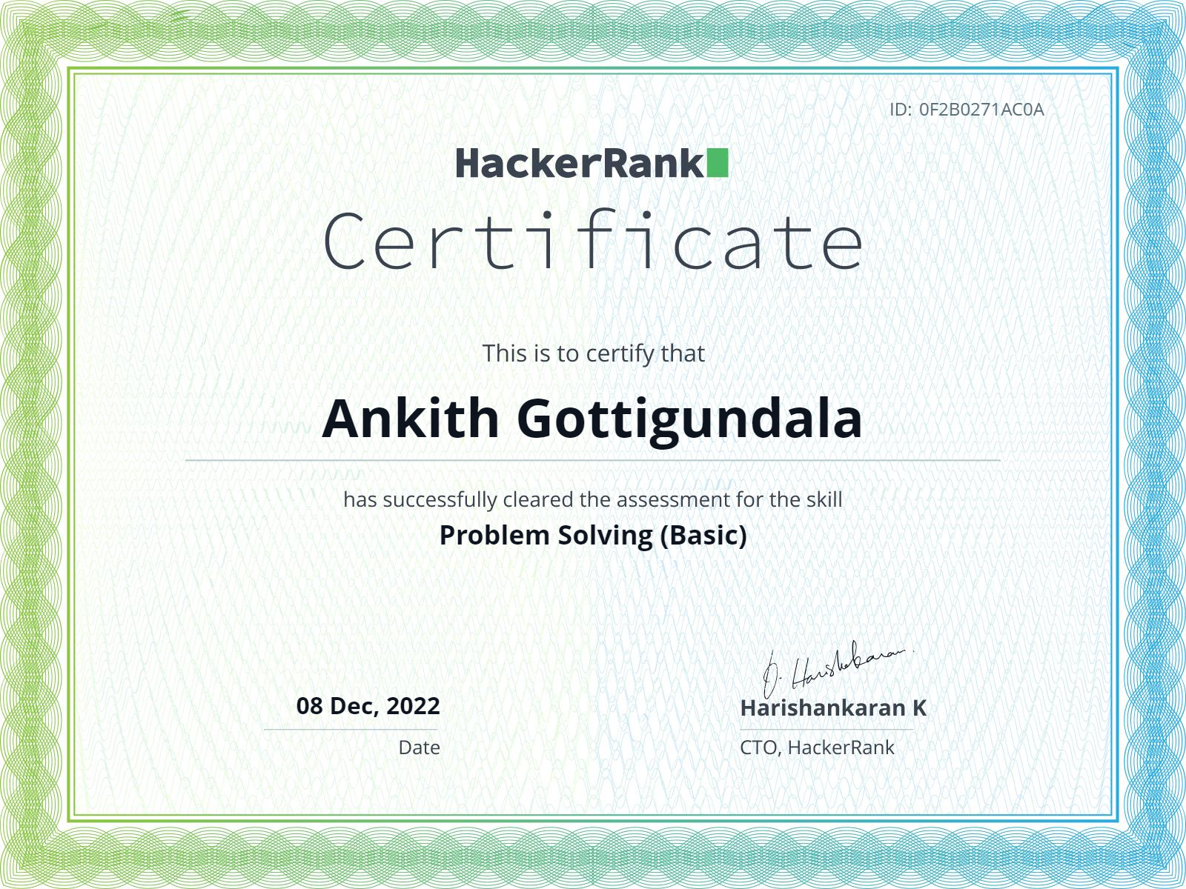
CERTIFICATE

